Slide 1
Election Security Assessment Status Update

Slide 2
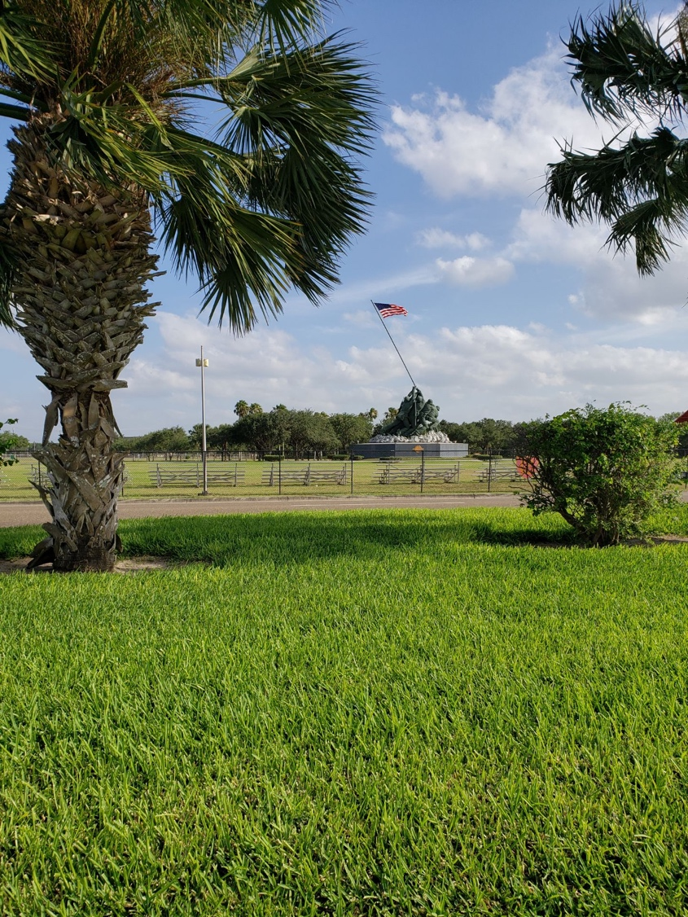
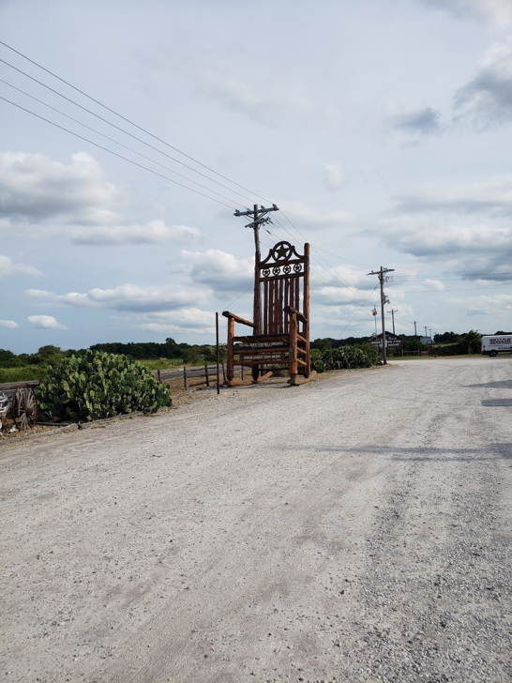
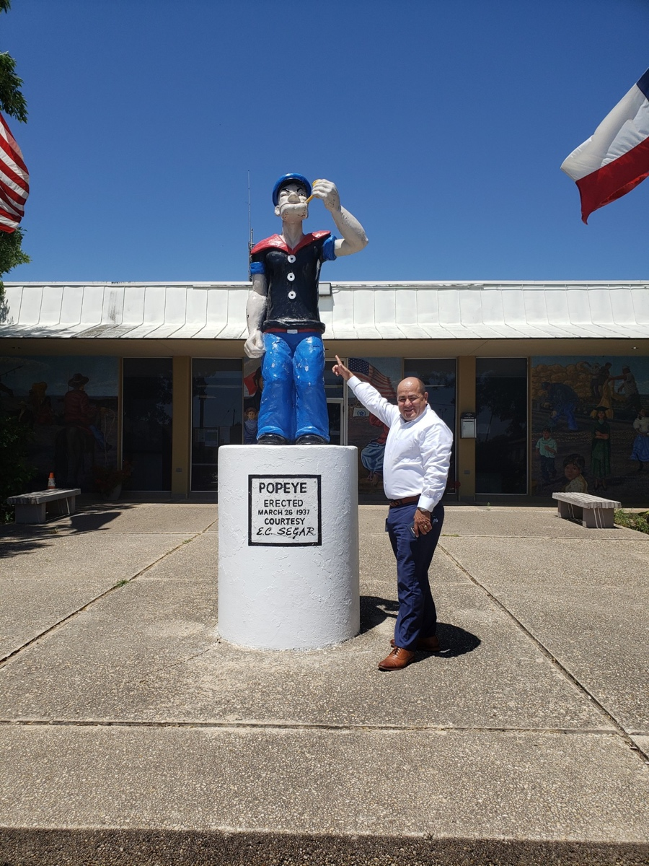
Waltz Across Texas

Slide 3
Election Security Assessments (ESA)
98% of Counties have signed up
85% of Counties have completed required Contracts
28% of Counties have started/completed assessment
177 Counties will be assessed over the next 6 months
Stage | Counties
Process Not Started | 5
Waiting for Contract | 32
In Scheduling | 145
In Progress | 6
Completed | 66
Please work with our schedulers when they call to lock in a time

Slide 4
The ESA In Real Life
Stephanie Garza
County Clerk
Kleberg County, TX
4

Slide 5
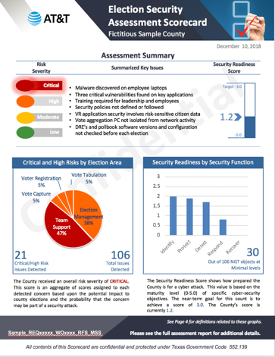
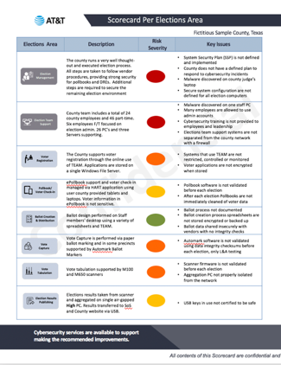
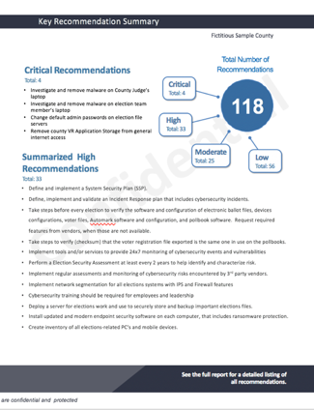
What Happens in the ESA?
Process occurs over 2 days
Conversational Interviews
Elections Administrator
Voter Registration
IT Leadership
Key Staff Members
Demonstration/Review of key parts of your election processes
Ballot Creation / Management
Voter Registration
Voting Machine Usage
Minimal IT Support is required
Understand how computers are setup and managed
Collect 24 hours of network traffic
Scan each computer
Physical Inspection & Review
Tabulation Network
Building / Physical Security
Review available Documents
Election Processes or Procedures
IT Policies
Security Policies
Follow-on Activities
Social Engineering Emails & Calls
Scans of your website
Review of the internet & darknet

Slide 6
Texas Election Security Best Practices
ELECTION PROCESS
8. Implement a two-person verification process
9. Election night reporting integrity
10. Document election processes
11. Physically secure election offices and systems
NETWORK AND INFRASTRUCTURE
12. Install a next generation firewall
13. Segment the network
14. Upgrade unsupported end-of-life operating systems and software.
15. Restrict network access
16. Use endpoint security solutions
17. Implement software and network whitelisting
18. Secure wireless networks and devices
19. Backup data offsite using encryption
20. Encrypt election and voter information
21. Manage removable media use
22. Track inventory
SUPPORTING TECHNOLOGY
23. Control email and website domain addresses
24. Implement email security
25. Passwords and multi-factor authentication (MFA)
26. Limit administrator access
DATA CLASSIFICATION
Confidential
Sensitive
Internal Use
Confidential
POLICIES AND PROCESS
1. Create an authorized election written information security program (wisp)
2. Monitor continuously for threats
3. Perform vulnerability scanning and patch management
4. Classify and protect elections data
5. Participate in security awareness training
6. Conduct election security assessments regularly
7. Participate in the DHS MS-ISAC and EI-ISAC info sharing program

Slide 7
Election Security Policies & Plan Templates
Election Information Security Policy
Specific Policies to be adapted and authorized by Election departments
Incident Response Plan (IRP)
Step-by-Step process to follow in case of Cybersecurity Incident
Continuity of Operations Plan (COO)
Preparations taken to be ready to continue operations
Election System Security Plan (ESSP)
Documentation of Specific Steps taken to secure a part of the election process
Vendor Risk Management Process
Steps for procuring and managing products that are integral to the Election Process

Slide 8
Discussion

